Slide 1
Neural Networks

Slide 2
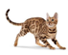
Neural Network
A standard Neural Network :
3 parts: one input layer, one or more hidden layer(s) and one output layer
Layers are connected
Each layer’ neurons use the same activation function
Also refers as a Multilayer Perceptron (MLP)
Dense/Linear layer
More details
Flatten

Slide 3
Forward Propagation
Outputs:
Hidden:
Inputs:

Slide 4
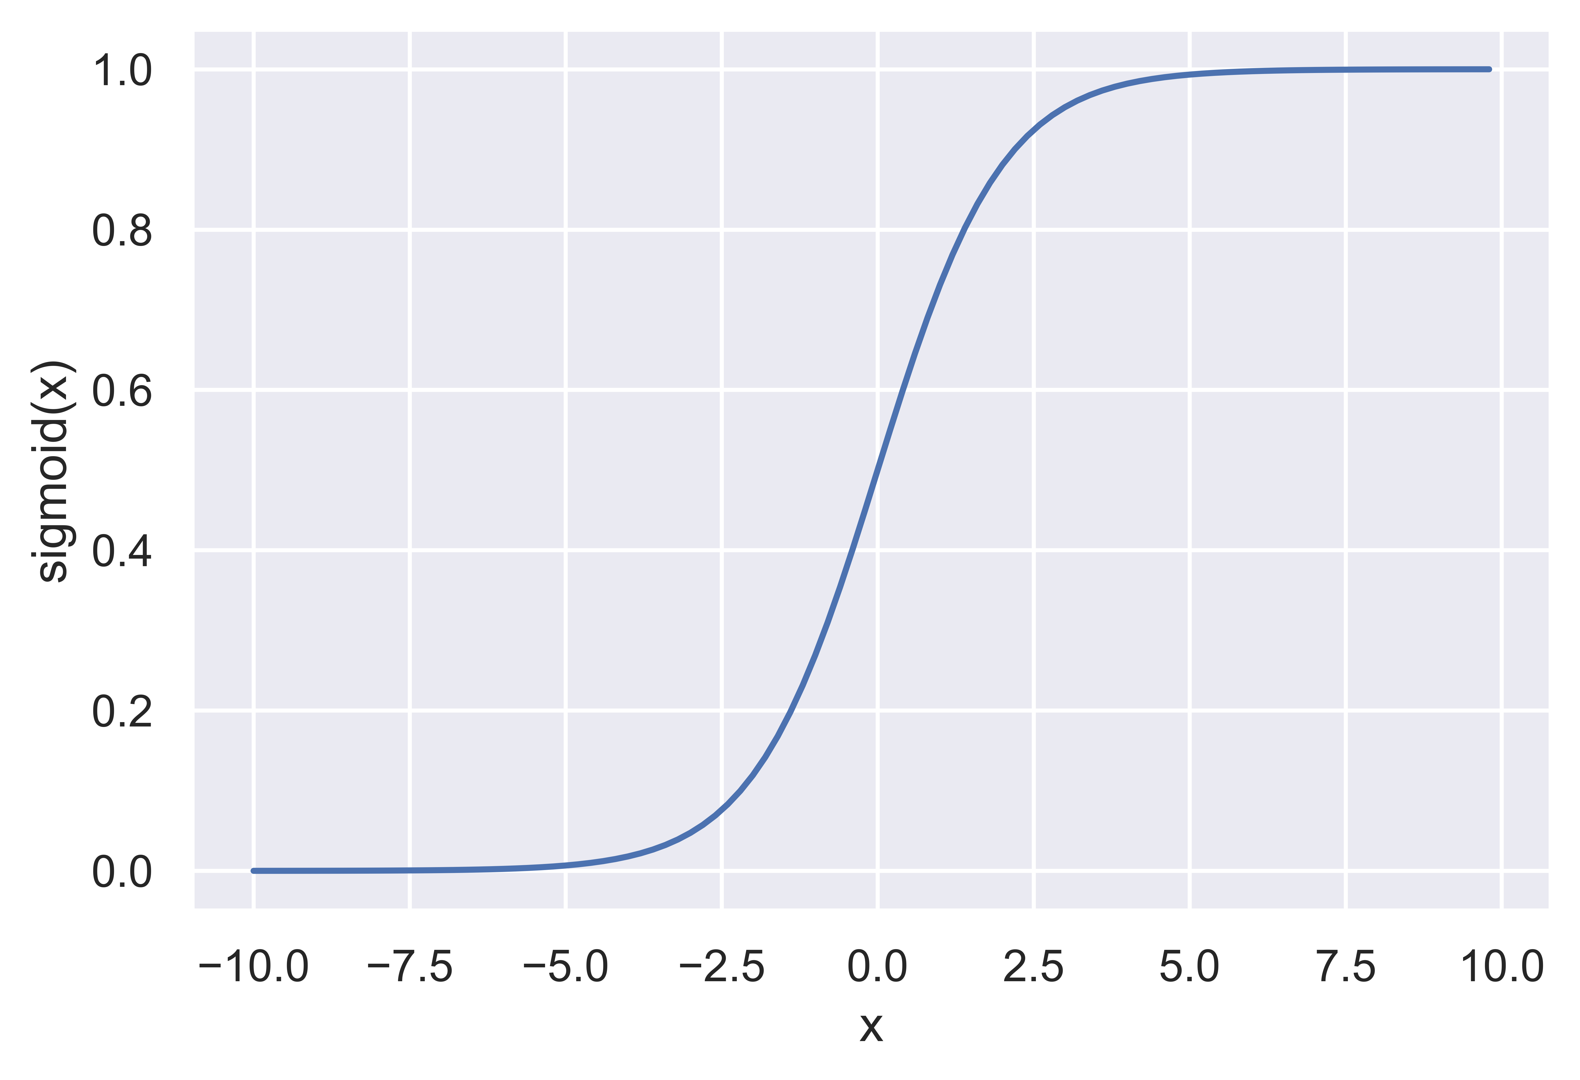

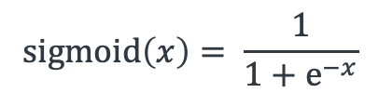
Output Function
“How to output/predict a result”
Binary classification: Sigmoid
Outputs a probability, P (class | x) in (0,1)
Multi-class classification: Softmax
Outputs a list of probabilities
Each probability represents for a class
Sum to be 1 (probability distribution)
Regression: Linear
$$sigmoid\left(x\right)= \frac{1}{1+e^{−x}}$$

Slide 5
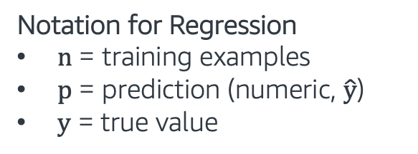
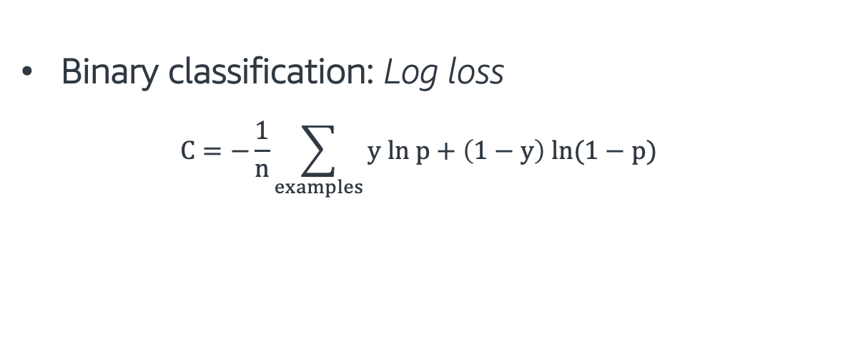
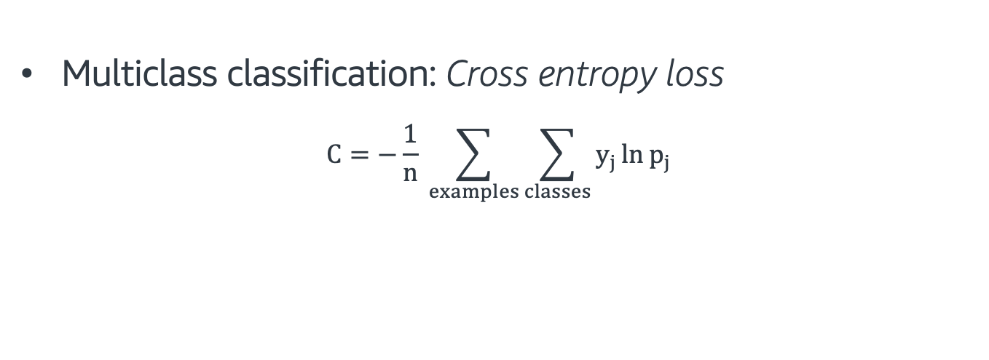
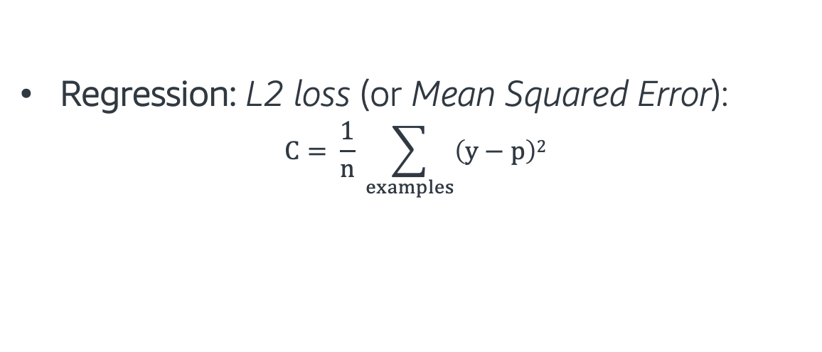
Cost Function
“How to measure the error?”
Binary classification: Log loss
$$C=−\frac{1}{n}\sum_{examples}{y ln p+\left(1−y\right) ln(1−p)}$$
Notation for Classification
n = training examples
j = classes
p = prediction (probability)
y = true class (1/yes, 0/no)
Multiclass classification: Cross entropy loss
$$C=−\frac{1}{n} \sum_{examples}{\sum_{classes}{y_{j}\ln{p_{j}}}}$$
Regression: L2 loss (or Mean Squared Error):
$$C= \frac{1}{n} \sum_{examples}{\left(y−p\right)2}$$
Notation for Regression
n = training examples
p = prediction (numeric, $\hat{y}$)
y = true value

Slide 6
Training
To “train” a model, we need to optimize the cost function C(w).
Also called objective function or loss function
w refers to the weights / parameters / coefficients of the model
Backpropagation searches for the weights that minimize the cost function.

Slide 7
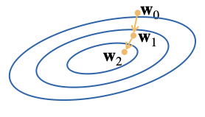
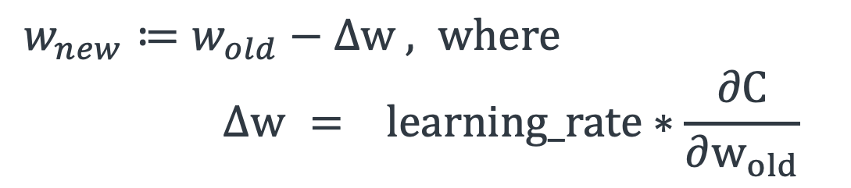
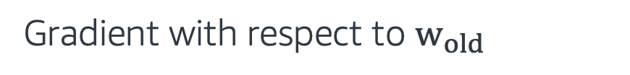
Backpropagation
Gradient descent:
An optimization method used to train neural networks
Moving towards the direction of the steepest descent iteratively
At each weight update:
$w_{new}≔w_{old}−∆w$ $, where$
$${ ∆w = }_{}learning_rate∗\frac{∂C}{∂w_{old}}$$
Gradient with respect to $w_{old}$

Slide 8
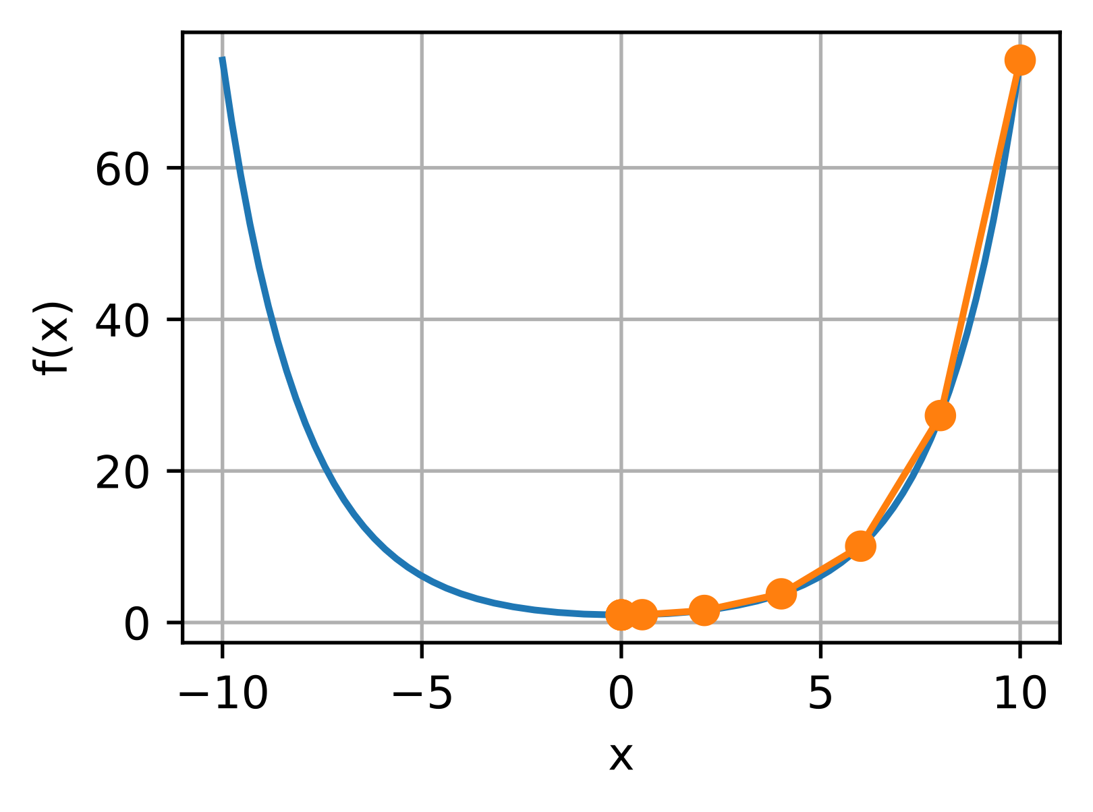
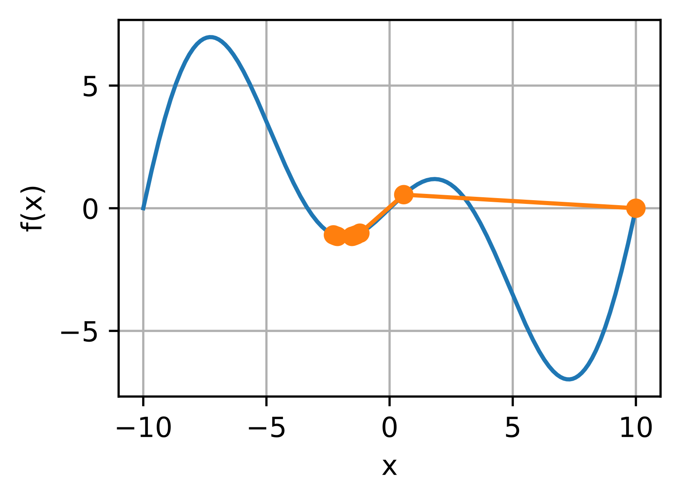
Gradient Descent
Initial Weights
Gradient
Global Cost Minimum

Slide 9
Backpropagation
Gradient descent:
An optimization method used to train neural networks
Moving towards the direction of the steepest descent iteratively
At each weight update:
$w_{new}≔w_{old}−∆w$ $, where$
$${ ∆w = }_{}learning_rate∗\frac{∂C}{∂w_{old}}$$

Slide 10

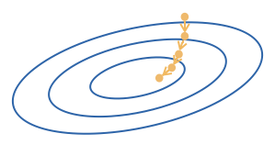
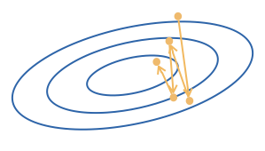
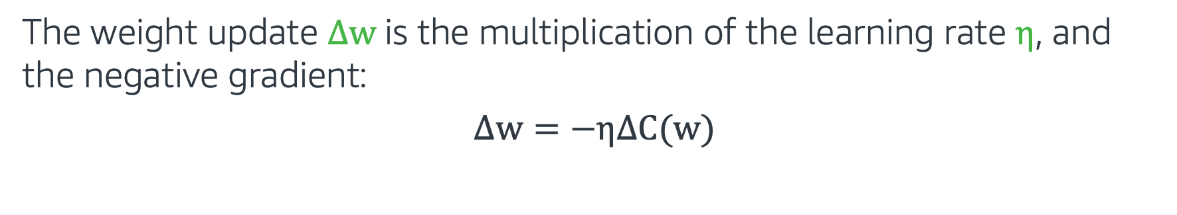
Learning Rate
The weight update $∆w$ is the multiplication of the learning rate $η$, and the negative gradient:
$$∆w=−η∆C(w)$$
Too small…
Too big…

Slide 11
Backpropagation
Gradient descent:
An optimization method used to train neural networks
Moving towards the direction of the steepest descent iteratively
At each weight update:
More details
$w_{new}≔w_{old}−∆w$ $, where$
$${ ∆w = }_{}learning_rate∗\frac{∂C}{∂w_{old}}$$

Slide 12
Summary: Deep Learning Jargons
Model Design
Architectures (# of layer, # of neurons at each layer, etc.)
Activation Function
A differentiable “nonlinear mapping”
Output Function
A function to predict ”y”
Cost/Loss Function
A differentiable function to optimize the model
Evaluation Function
An often non-differentiable function to evaluate the model

Slide 13

Neural Networks - Hands on
In this exercise, we implement a standard neural network using the Gluon Library.
Gluon is an open source deep learning library.
The exercise covers the following topics:
Sequential module
Loss functions
Trainer module
Follow through this notebook: MLA-CV-DAY1-NN.ipynb
Run the notebook from your SageMaker instance.

